Slide 1
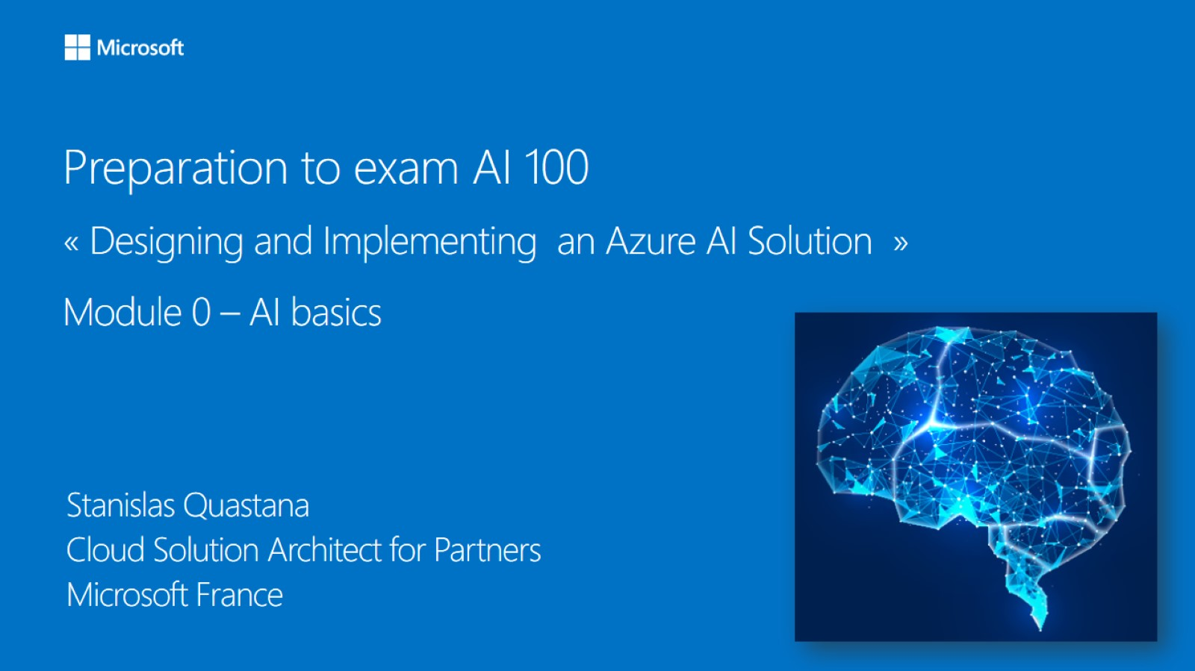

Rahman Oridedi
Technology Strategist
Microsoft

Slide 2
Contact me
Email: raorided@microsoft.com
GitHub: https://github.com/roridedi

Slide 3
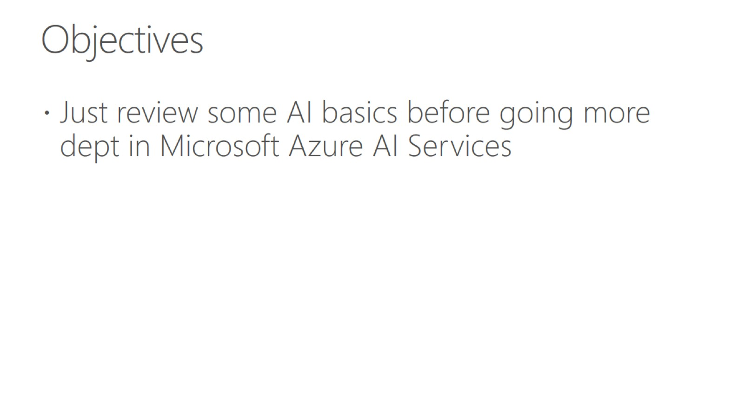
Objectives

Slide 4
Agenda - Prepare for the Microsoft AI 100 certification exam
December 9th – December 12th
Theory
Lots of hands on labs
Practice questions

Slide 5
What is the Microsoft AI 100 exam?
AI-100 Certification is for engineers who have intermediate to an expert level understanding of Machine Learning and are responsible for deploying end-to-end AI solutions on Azure using various AI & ML services.

Slide 6
Topics covered by AI-100
Azure Cognitives Services (a lot of questions)
Azure AI + AKS + ACI
Azure IoT Edge + Azure Stack + Azure DataBox Edge
IoT Hub + EventBus
Azure Storage
Azure Stream Analytics
Azure Functions + Azure Logic App
LUIS
Monitoring Apps & AI applications
Azure Bot Service + QnA Maker + Cognitives Services
Security (Authentication, Azure Key Vault)

Slide 7
What is AI?

Slide 8


Many concepts

Slide 9
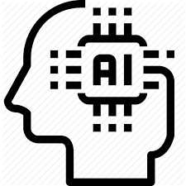


Three nested concepts
Artificial Intelligence
Machine Learning
Deep Learning
Artificial Intelligence: AI refers to scenarios where a machine mimics the cognitive functions associated with human minds.
Machine Learning: A subset of AI -- self-learning algorithms that detect patterns and anomalies. They get better as they consume more data (but that improvement will eventually level off, and more data will not lead to an increase in performance). Machine Learning does two things: It senses and predicts.
Deep Learning: A subset of Machine Learning. Deep learning is also best applied to problems centering around perception and language. To keep this simple, think of the concept of machine learning -- but when it comes to deep learning, there’s no ‘ceiling’ of improvement based on data ingestion. It continues to get better, and the only limitation is your ability to feed it more data. Here, you need massive computational power.
Notes:
Deep learning is a subset of machine learning that's based on artificial neural networks. The learning process is deep because the structure of artificial neural networks consists of multiple input, output, and hidden layers. Each layer contains units that transform the input data into information that the next layer can use for a certain predictive task. Thanks to this structure, a machine can learn through its own data processing.
Machine learning is a subset of artificial intelligence that uses techniques (such as deep learning) that enable machines to use experience to improve at tasks. The learning process is based on the following steps:
Feed data into an algorithm. (In this step you can provide additional information to the model, for example, by performing feature extraction.)
Use this data to train a model.
Test and deploy the model.
Consume the deployed model to do an automated predictive task. (In other words, call and use the deployed model to receive the predictions returned by the model.)
Artificial intelligence (AI) is a technique that enables computers to mimic human intelligence. It includes machine learning.
Deep Learninig Examples
Text analytics
Text analytics based on deep learning methods involves analyzing large quantities of text data (for example, medical documents or expenses receipts), recognizing patterns, and creating organized and concise information out of it.

Slide 10
Big Data
Breakthroughs
Enabling
AI
Powerful Algorithms
Cloud Computing

Slide 11
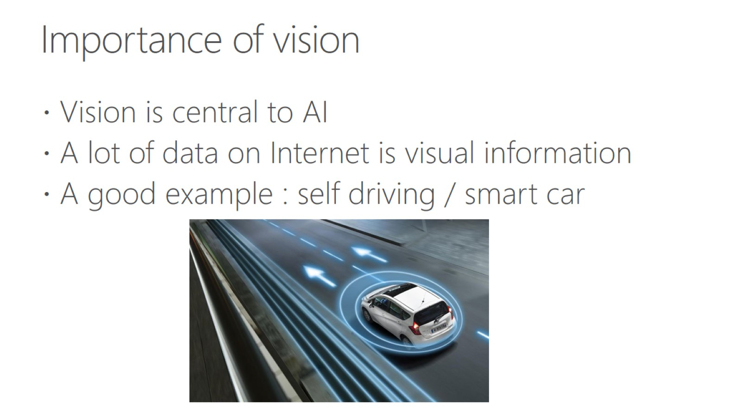
Importance of vision
Notes:
Azure's Computer Vision service provides developers with access to advanced algorithms that process images and return information based on the visual features you're interested in. For example, Computer Vision can determine whether an image contains adult content, find specific brands or objects, or find human faces.

Slide 12
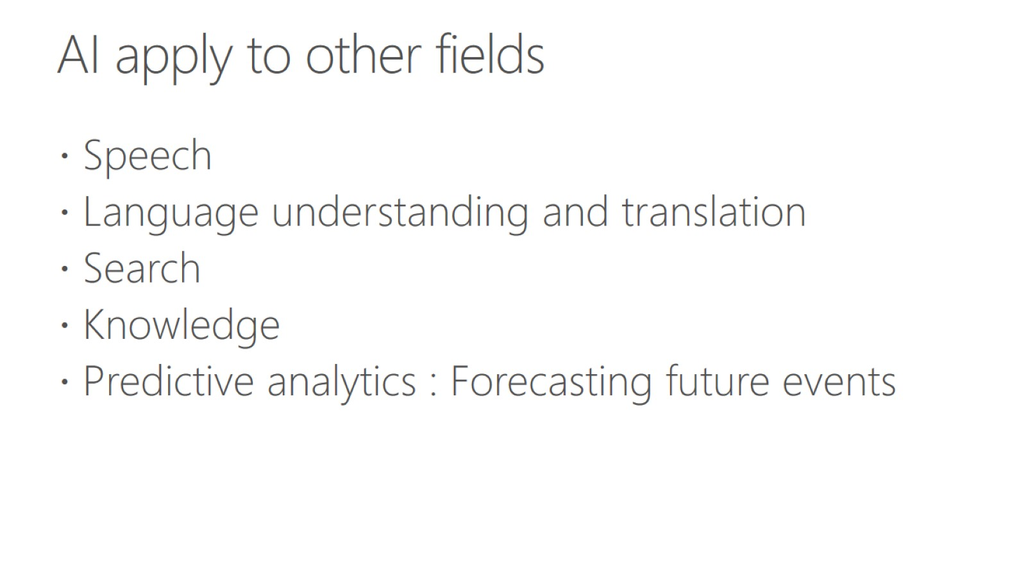
AI apply to other fields

Slide 13
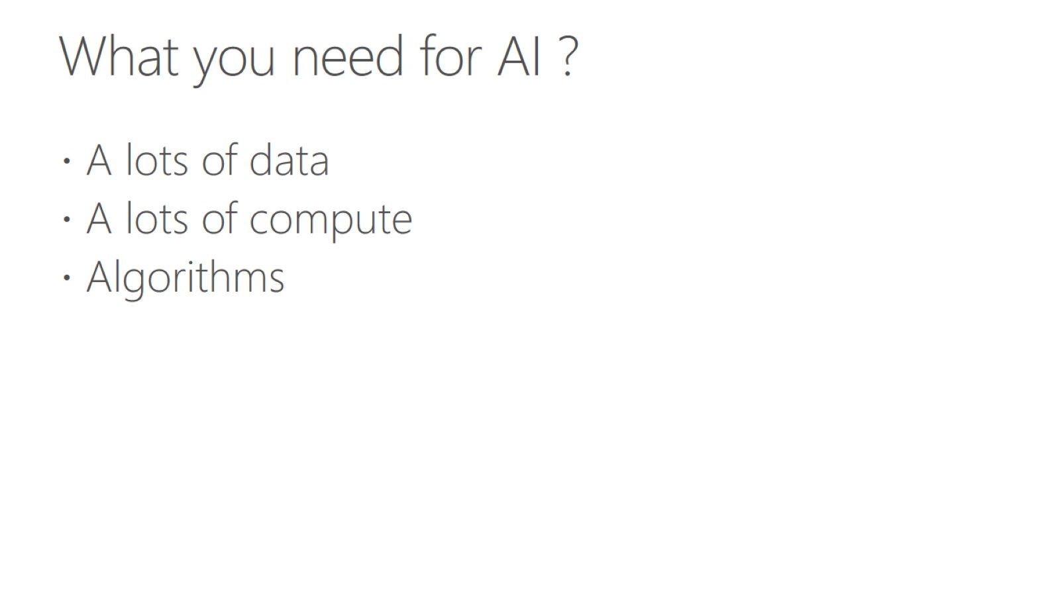
What you need for AI ?

Slide 14
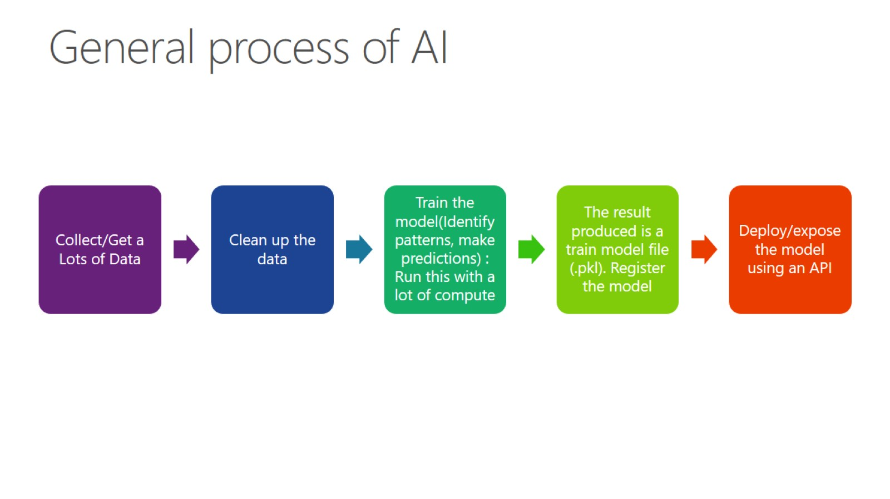
General process of AI

Slide 15
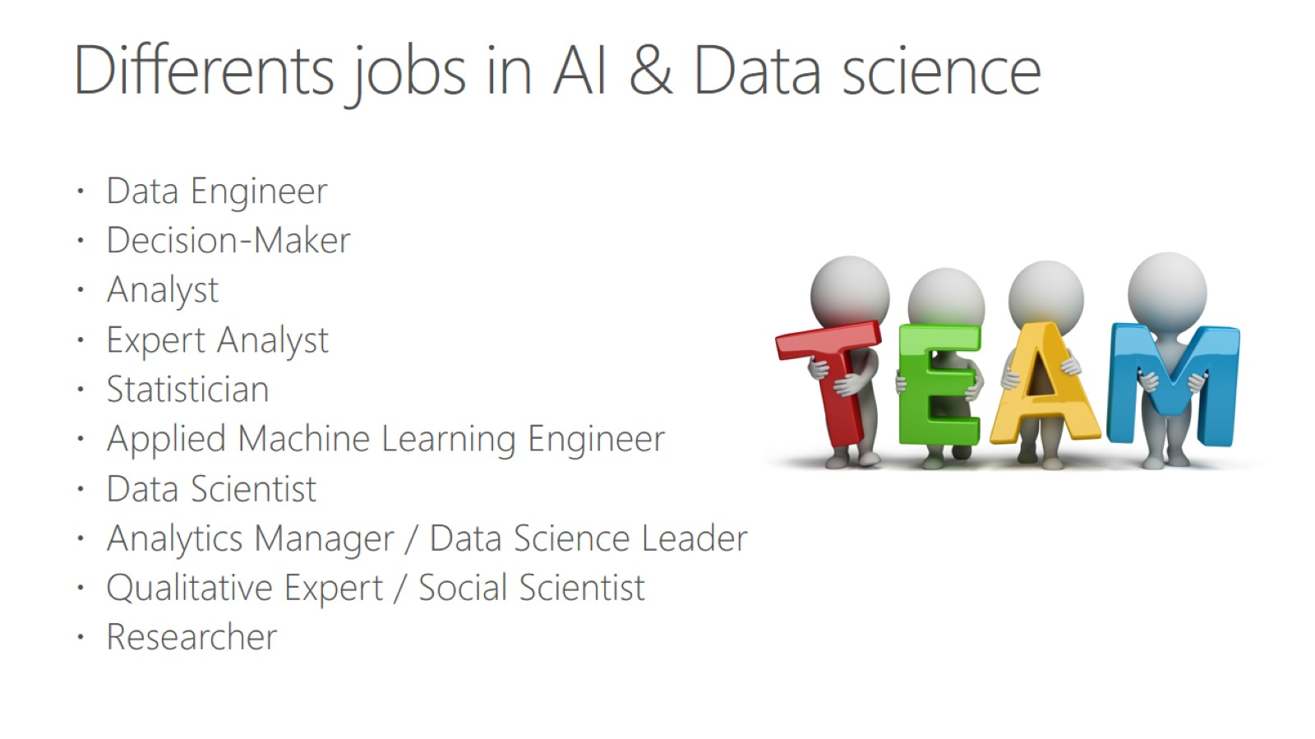
Differents jobs in AI & Data science

Slide 16
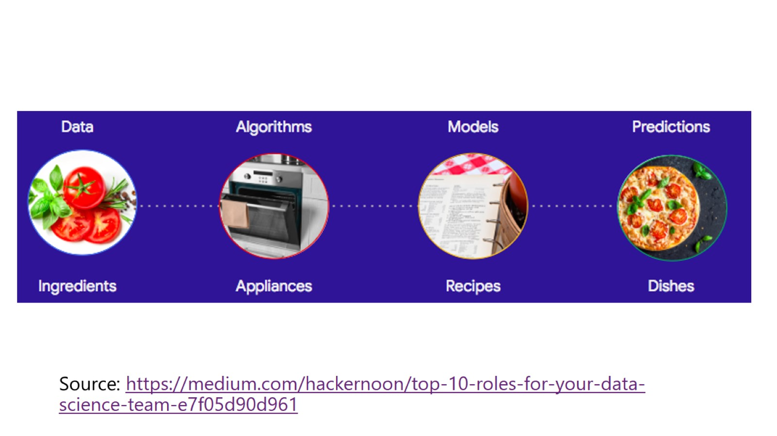

Slide 17
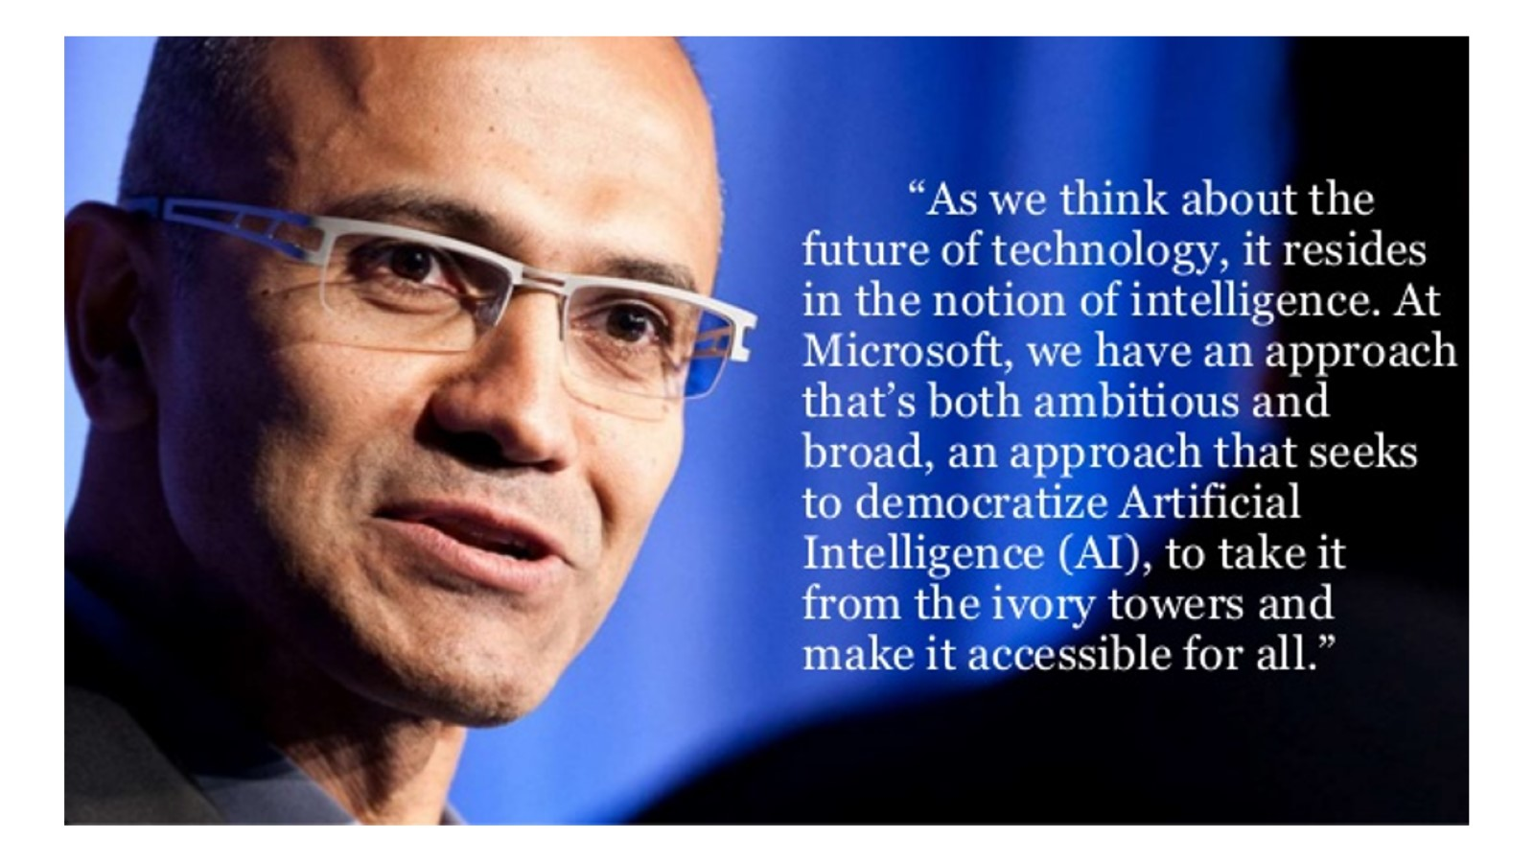

Slide 18
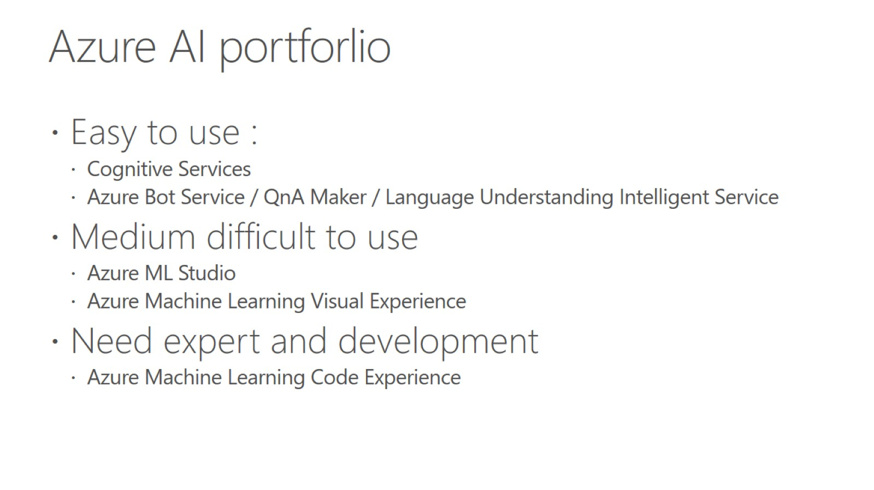
Azure AI portforlio

Slide 19
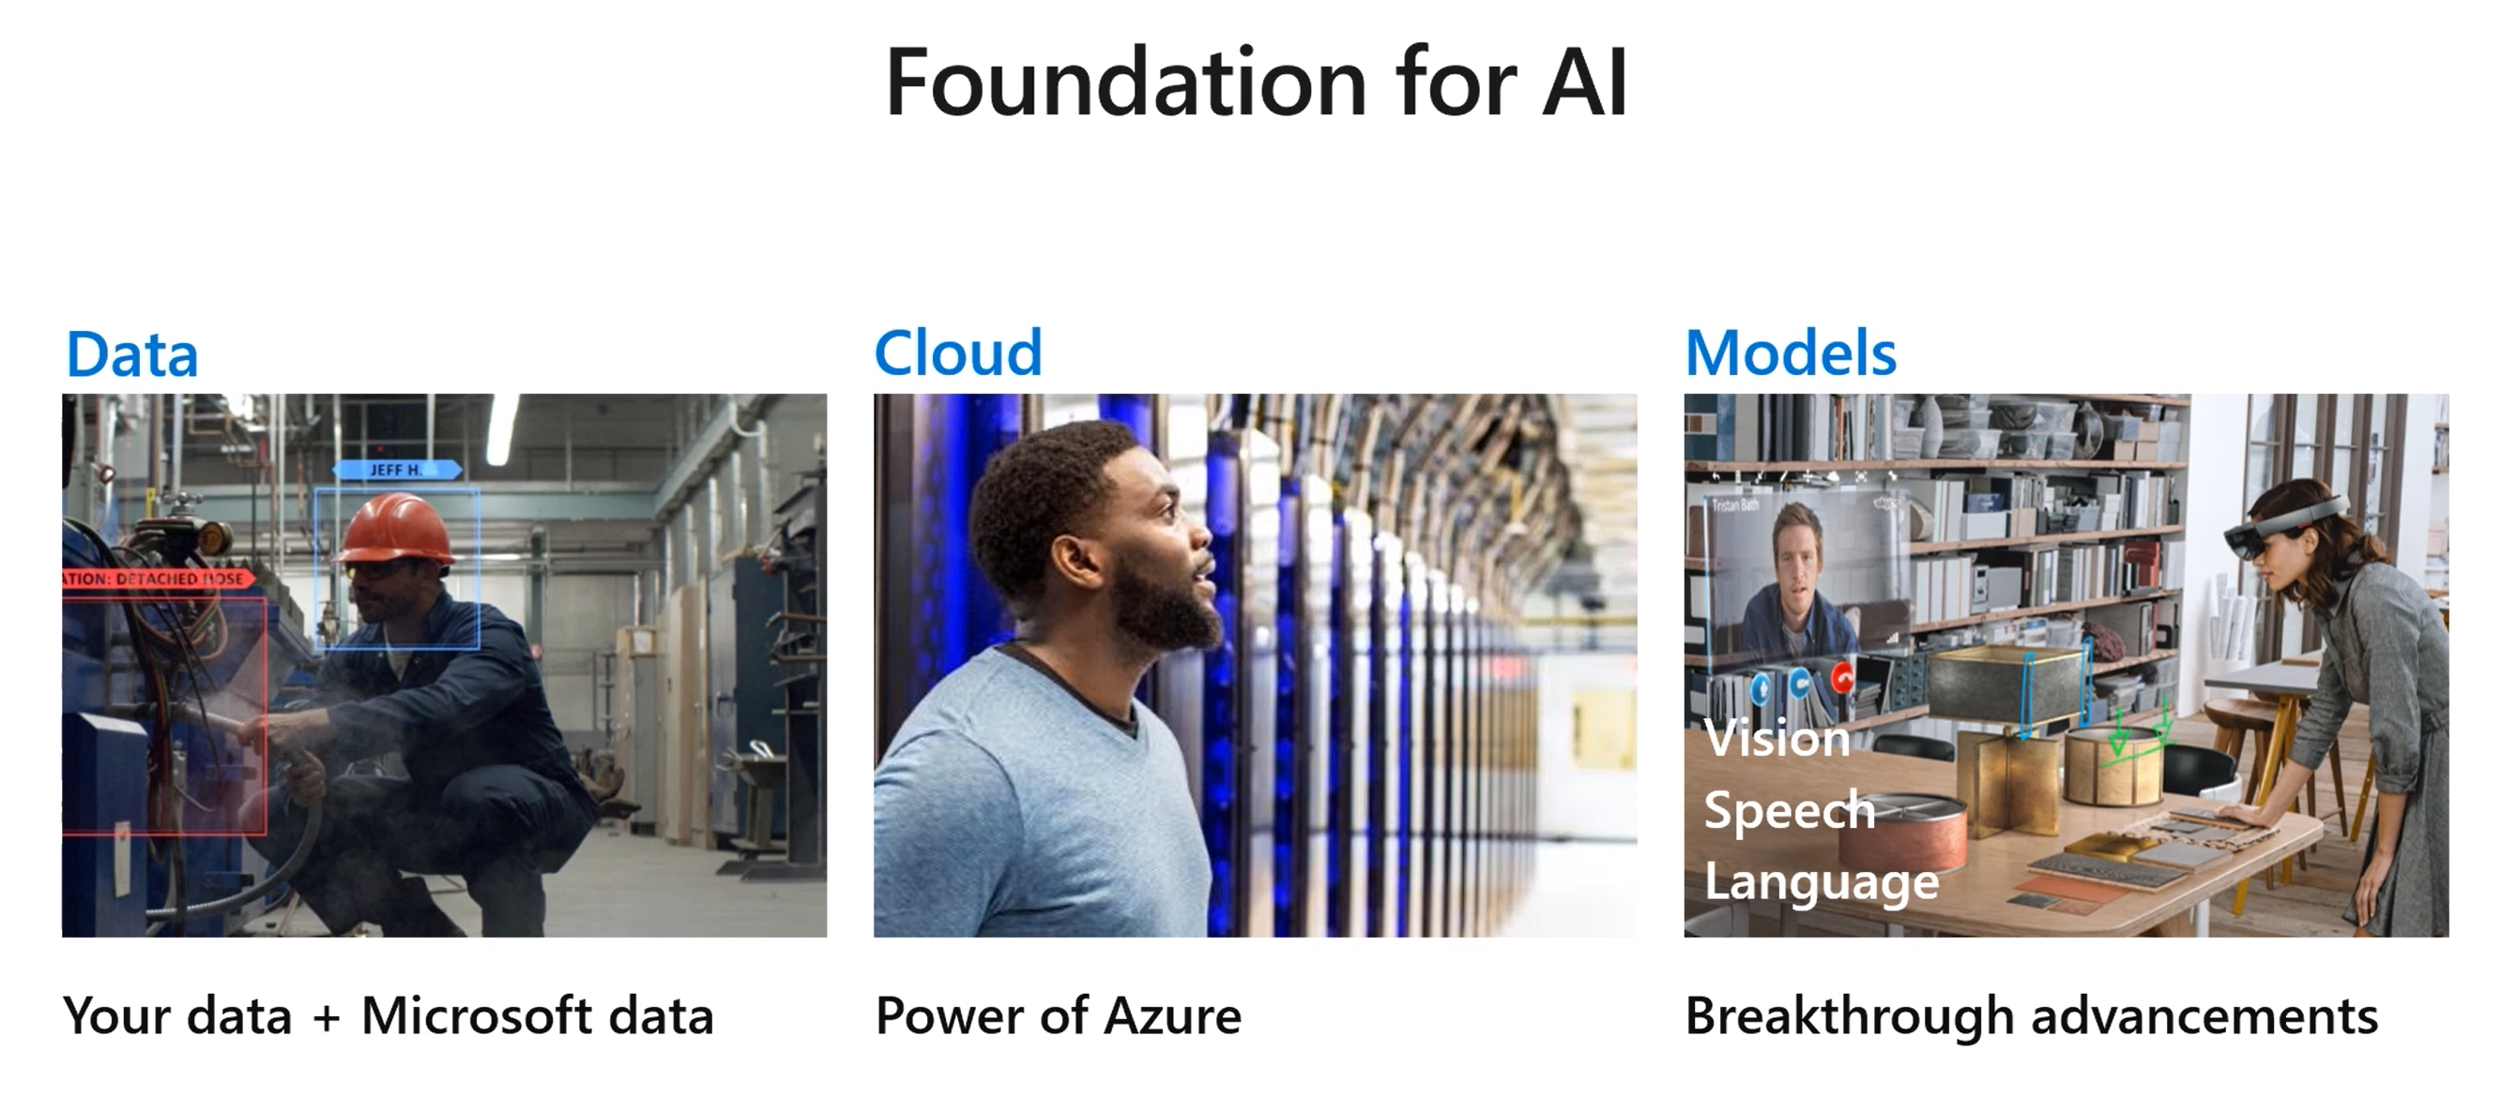
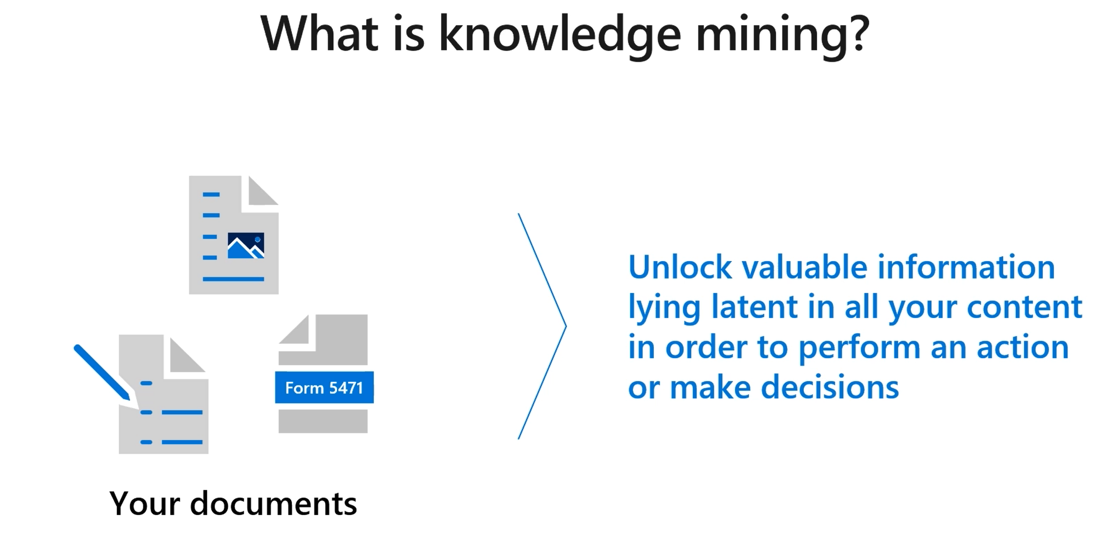
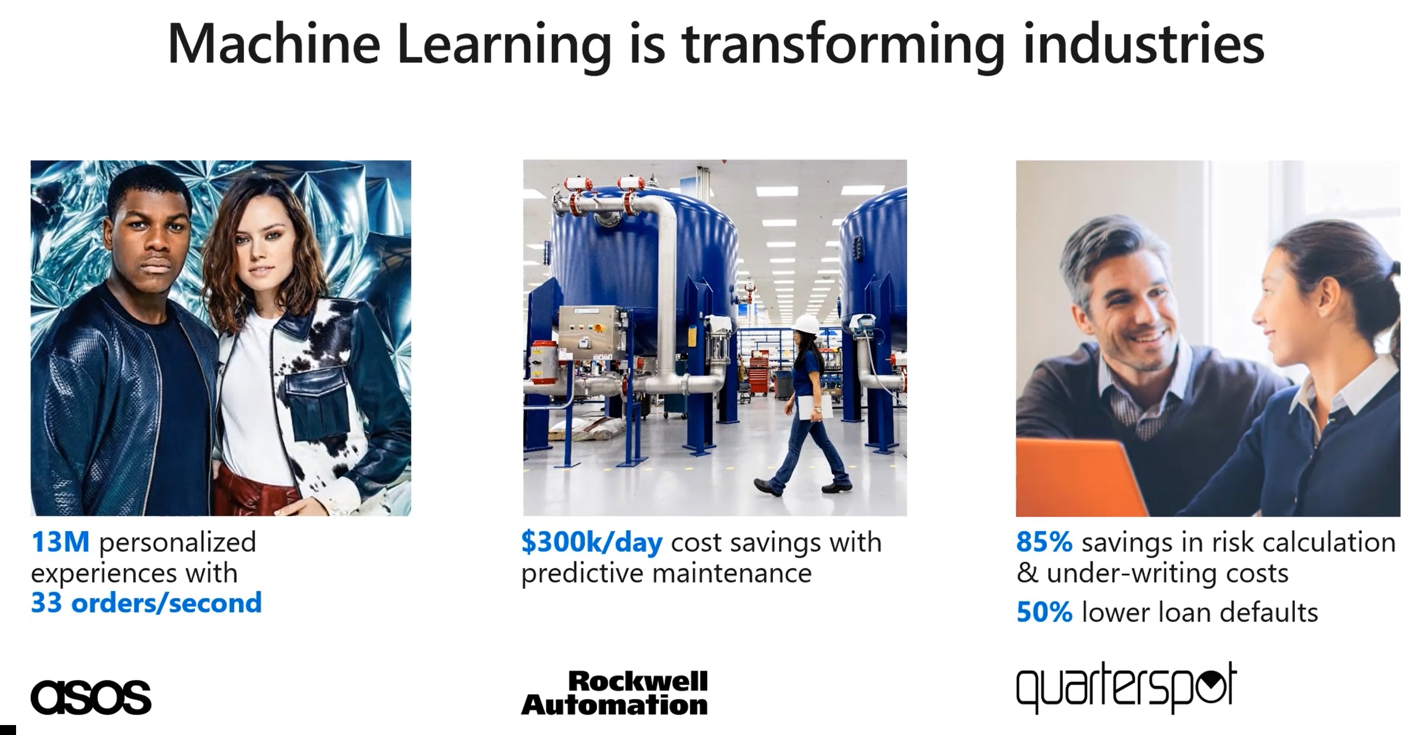
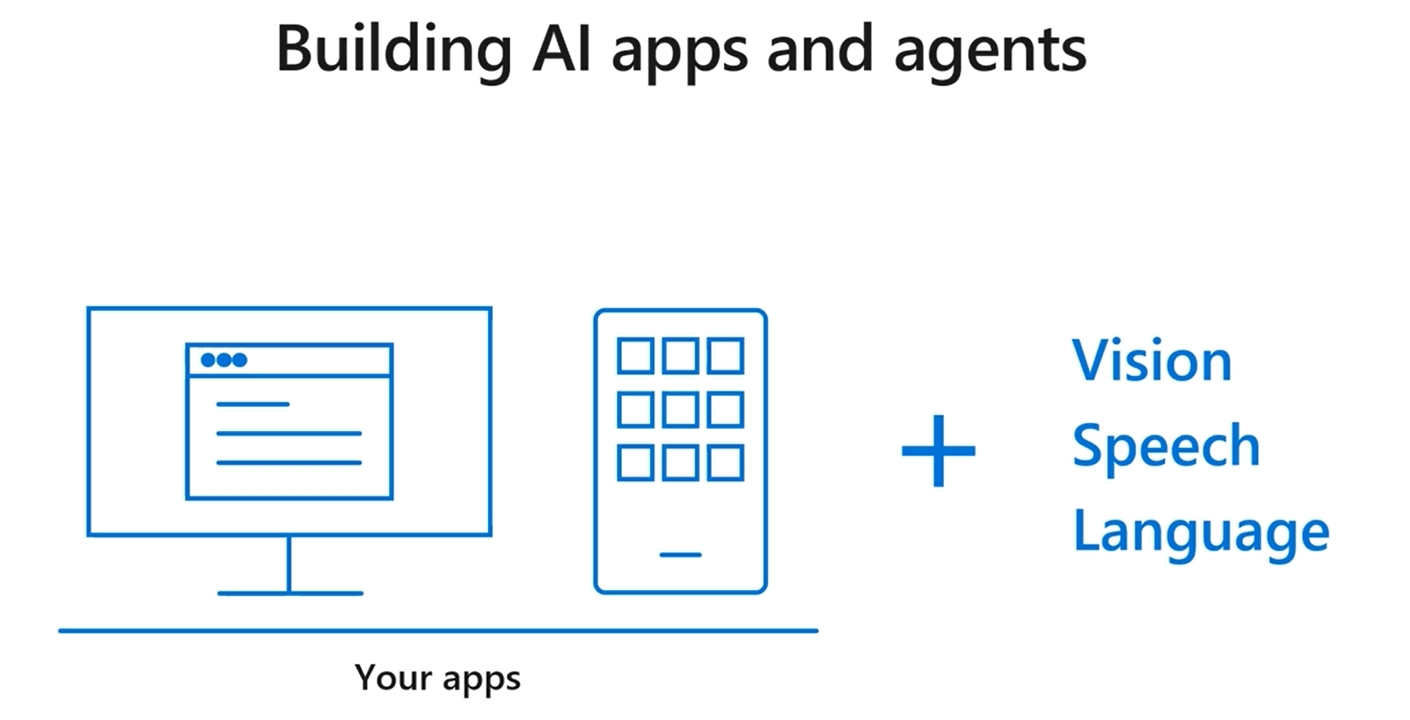
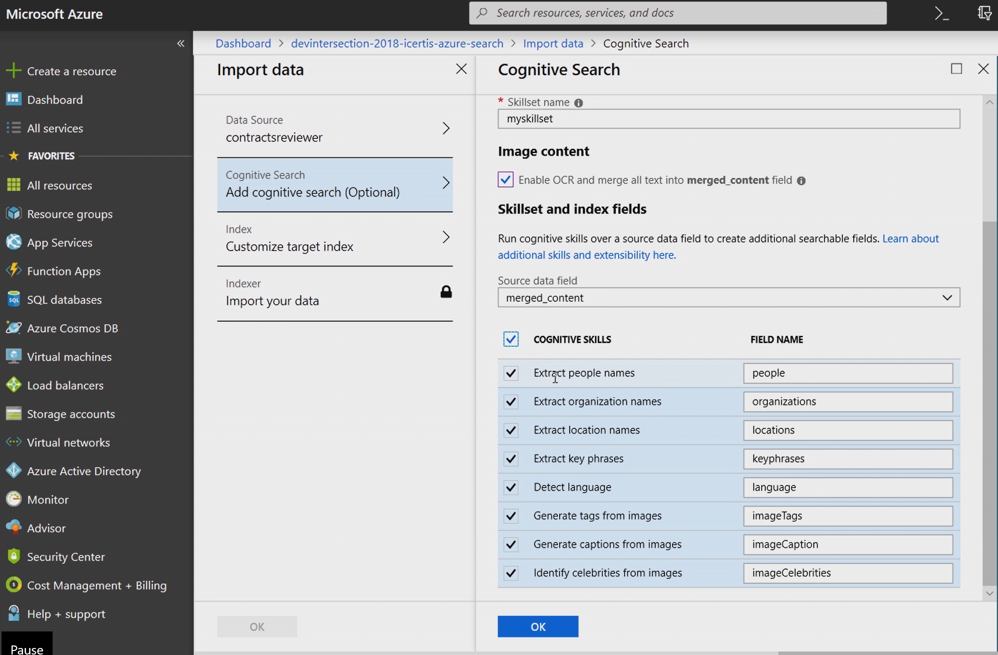
Understanding the concepts
Notes:
https://docs.microsoft.com/en-us/azure/machine-learning/tutorial-designer-automobile-price-train-score

